Slide 1

Transformers and Autoencoders in Machine Learning
Presented by Sumukhi Tripathi

Slide 2
Agenda
Introduction
Role of representation learning in ML
Rise of deep neural networks
Autoencoders
What are Autoencoders?
Architecture and Types
Applications and Use Cases
Transformers
Limitations of RNNs
Attention Mechanism
Transformer Architecture
Applications & Popular Models
BERT, GPT, Vision Transformers
Autoencoders in anomaly detection, denoising, compression
Comparison & Use-case Suitability
When to use Autoencoders vs Transformers
Emerging Trends
Transformer-based Autoencoders
Vision + Language hybrid models

Slide 3
Introduction
Machine Learning (ML) thrives on learning representations from data.
Two powerful architectures have reshaped how we process and understand data:
Autoencoders: Used for compression, reconstruction, and anomaly detection.
Transformers: Revolutionized natural language processing and now expanding into vision, audio, and more.
Why these two models?
Autoencoders enable unsupervised learning by learning compressed latent representations.
Transformers excel at sequence modeling using self-attention, replacing traditional RNNs.
Together, these models form the backbone of modern AI systems, enabling breakthroughs in text generation, image understanding, and more.

Slide 4
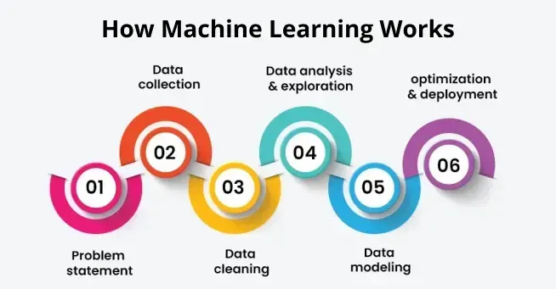
Basics of Machine Learning
Machine learning is a branch of Artificial Intelligence that focuses on developing models and algorithms that let computers learn from data without being explicitly programmed for every task. In simple words, ML teaches the systems to think and understand like humans by learning from the data.

Slide 5
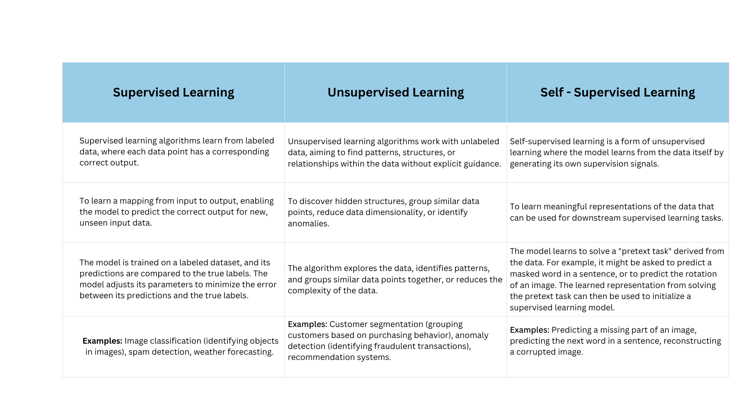
Types

Slide 6
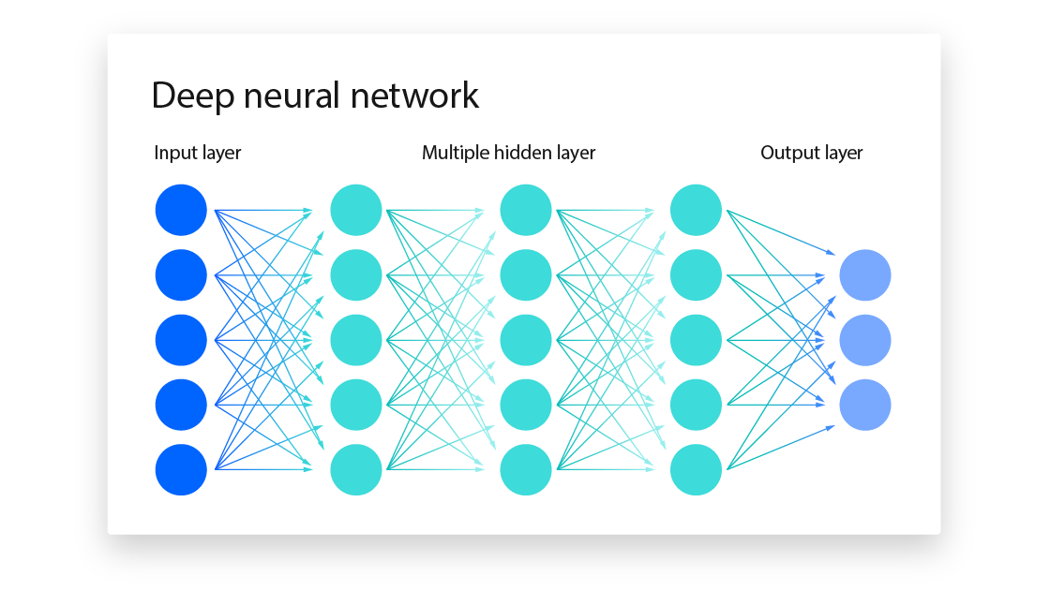
What are Neural Networks?
A neural network is a machine learning program, or model, that makes decisions in a manner similar to the human brain, by using processes that mimic the way biological neurons work together to identify phenomena, weigh options and arrive at conclusions. They are sometimes called artificial neural networks (ANNs) or simulated neural networks (SNNs). They are a subset of machine learning, and at the heart of deep learning models.
Convolutional neural networks (CNNs) are similar to feedforward networks, but they’re usually utilized for image recognition, pattern recognition, and/or computer vision. These networks harness principles from linear algebra, particularly matrix multiplication, to identify patterns within an image.
Recurrent neural networks (RNNs) are identified by their feedback loops. These learning algorithms are primarily leveraged when using time-series data to make predictions about future outcomes, such as stock market predictions or sales forecasting.

Slide 7
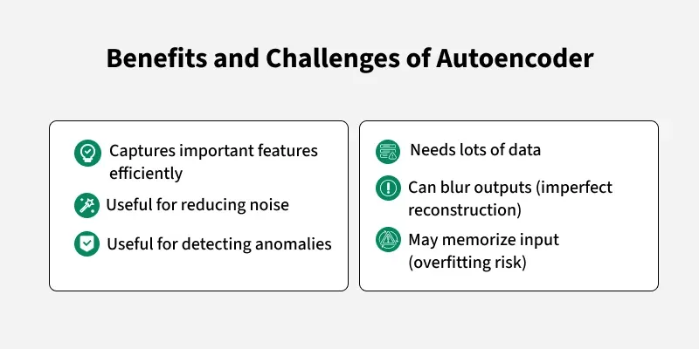
Autoencoders
Autoencoders are a special type of neural networks that learn to compress data into a compact form and then reconstruct it to closely match the original input. They consist of an:
Encoder that captures important features by reducing dimensionality.
Decoder that rebuilds the data from this compressed representation.
The model trains by minimizing reconstruction error using loss functions like Mean Squared Error( average squared differences between the input and the reconstructed data) or Binary Cross-Entropy(difference in probability between the original and reconstructed output). These are applied in tasks such as noise removal, error detection and feature extraction where capturing efficient data representations is important.
Efficient Representations in Autoencoders
Keep Small Hidden Layers: Limiting the size of each hidden layer forces the network to focus on the most important features which reduces redundancy and allows efficient encoding.
Regularization: Techniques like L1 or L2 regularization add penalty terms to the loss function. This prevents overfitting by removing excessively large weights which helps in ensuring the model to learns general and useful representations.
Denoising: In denoising autoencoders random noise is added to the input during training. It learns to remove this noise during reconstruction which helps it focus on core, noise-free features and helps in improving robustness.
Tuning the Activation Functions: Adjusting activation functions can promote sparsity by activating only a few neurons at a time which reduces model complexity and forces the network to capture only the most relevant features.

Slide 8
Architecture of Autoencoders
1. Encoder
2. Bottleneck (Latent Space)
3. Decoder
It compress the input data into a smaller, more manageable form by reducing its dimensionality while preserving important information.
Input Layer: This is where the original data enters the network like images, text features or any other structured data.
Hidden Layers: These layers perform a series of transformations on the input data. Each hidden layer applies weights and activation functions to capture important patterns, progressively reducing the data's size and complexity.
Output(Latent Space): The encoder outputs a compressed vector(latent representation or encoding). This vector captures the important features of the input data in a condensed form helps in filtering out noise and redundancies.
It is responsible for taking the compressed representation from the latent space and reconstructing it back into the original data form.
Hidden Layers: These layers progressively expand the latent vector back into a higher-dimensional space. Through successive transformations decoder attempts to restore the original data shape and details
Output Layer: The final layer produces the reconstructed output which aims to closely resemble the original input. The quality of reconstruction depends on how well the encoder-decoder pair can minimize the difference between the input and output during training.
It is the smallest layer of the network which represents the most compressed version of the input data. It serves as the information bottleneck which force the network to prioritize the most significant features. This compact representation helps the model learn the underlying structure and key patterns of the input helps in enabling better generalization and efficient data encoding.

Slide 9
Types of Autoencoders
Denoising Autoencoder
Sparse Autoencoder
It contains more hidden units than input features but only allows a few neurons to be active simultaneously. This sparsity is controlled by zeroing some hidden units, adjusting activation functions or adding a sparsity penalty to the loss function.
It is trained to handle corrupted or noisy inputs, it learns to remove noise and helps in reconstructing clean data. It prevent the network from simply memorizing the input and encourages learning the core features.
Variational Autoencoder
Convolutional Autoencoder
It makes assumptions about the probability distribution of the data and tries to learn a better approximation of it. It uses stochastic gradient descent to optimize and learn the distribution of latent variables. They used for generating new data such as creating realistic images or text.
It assumes that the data is generated by a Directed Graphical.
It uses convolutional neural networks (CNNs) which are designed for processing images. The encoder extracts features using convolutional layers and the decoder reconstructs the image through deconvolution also called as upsampling.

Slide 10
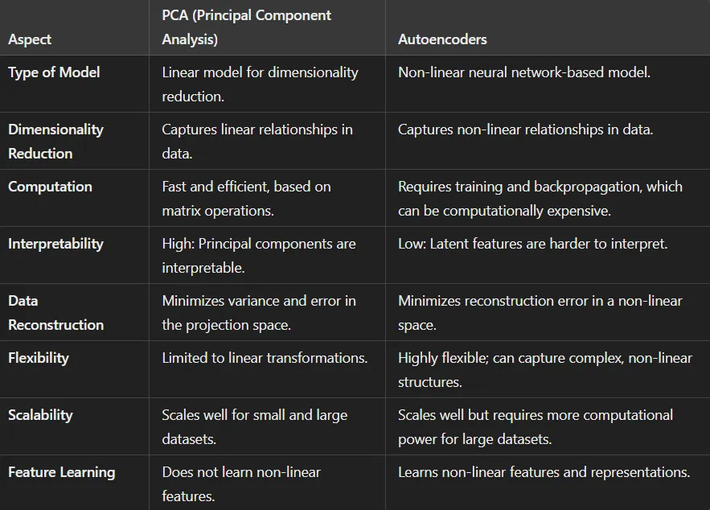
Autoencoder Applications
Dimensionality Reduction
It is an essential technique that helps simplify high-dimensional data while retaining the most critical features. Two popular methods for dimensionality reduction are Principal Component Analysis (PCA) and Autoencoders.
For PCA, Let ‘X’ be the input data matrix (standardized), and the goal is to find the projection matrix ‘W’ (eigenvectors) that transforms ‘X’ into a lower-dimensional subspace: Z=XW where Z=projected data (reduced dimensions). The principal components maximize the variance:
where Zi are principal components
For Autoencoders, Let ‘X’ represent the input data, and the Autoencoder consists of an encoder function ‘f’ and a decoder function ‘g’
Z = f(X) → (Encoding: compressed representation)
X^ = g(Z) → (Decoding: reconstruction of the input)
The Autoencoder aims to minimize the reconstruction loss ‘L’ between the input ‘X’ and its reconstruction ‘X^’:

Slide 11
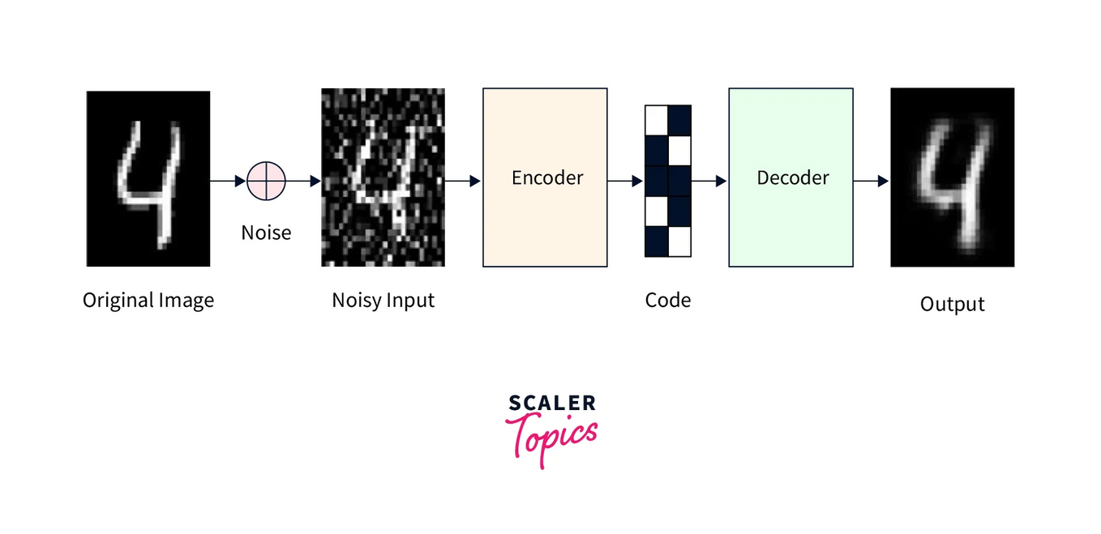
Autoencoder Applications
Image Denoising
Autoencoders, particularly denoising autoencoders, are effectively used for image denoising. They work by learning to reconstruct a clean image from a corrupted (noisy) version, essentially acting as noise filters.
How it works:
1. Noisy Image Input: A noisy image, created by
adding random noise to a clean image, is fed into the
autoencoder.
2. Encoding: The autoencoder's encoder part compresses
the noisy image into a lower-dimensional representation, capturing the essential features while discarding noise.
3. Decoding: The decoder part then reconstructs the image from this compressed representation, aiming to produce a clean version.
4. Loss Function: A loss function compares the reconstructed image with the original clean image. The autoencoder is trained to minimize this loss, improving its ability to remove noise.

Slide 12
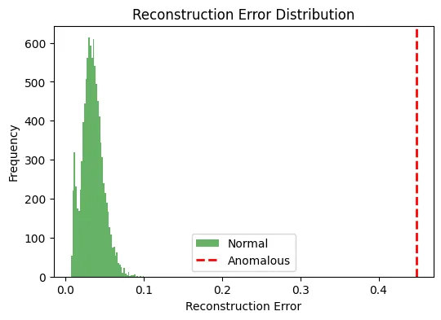
Autoencoder Applications
Anomaly Detection
Anomaly detection is a crucial task in various industries, from fraud detection in finance to fault detection in manufacturing. Autoencoders are trained on normal data to learn the representation of the normal state. During inference, if an input significantly deviates from this learned representation, the AutoEncoder will likely reconstruct it poorly. This poor reconstruction is a signal of an anomaly.
How it works:
Training: The AutoEncoder is trained exclusively on normal data. The training process involves adjusting the weights to minimize the reconstruction error.
Inference: During inference, we feed new data to the Autoencoder. If the data is normal, the AutoEncoder will successfully reconstruct it with minimal error. However, if the data is anomalous, the reconstruction error will be significantly higher.
Thresholding: We set a threshold for the reconstruction error. If the error surpasses this threshold, the data point is flagged as an anomaly.

Slide 13
Autoencoder Applications
Data Compression and Generation
Data Compression
Data Generation
Autoencoders learn a compact representation (latent code) of input data through the bottleneck layer. This representation:
Retains essential information
Reduces dimensionality
Is useful for storage-efficient encoding
Example Use-Cases:
Compressing high-dimensional sensor data
Reducing image size without major loss of quality
Preprocessing step for downstream ML tasks
How?
Input → Encoder → Compressed Code → Decoder → Reconstructed Output
Compression achieved by forcing the network to learn efficient, low-dimensional features
Autoencoders can generate new data that resembles the original training set.
Especially true for Variational Autoencoders (VAEs), which model probability distributions in latent space.
Applications:
Generating synthetic images (e.g., faces, digits)
Data augmentation for training
Filling missing/incomplete data
Key Concept:
Latent space → Smooth & Continuous
Sampling from this space → Decoding → New data instances

Slide 14
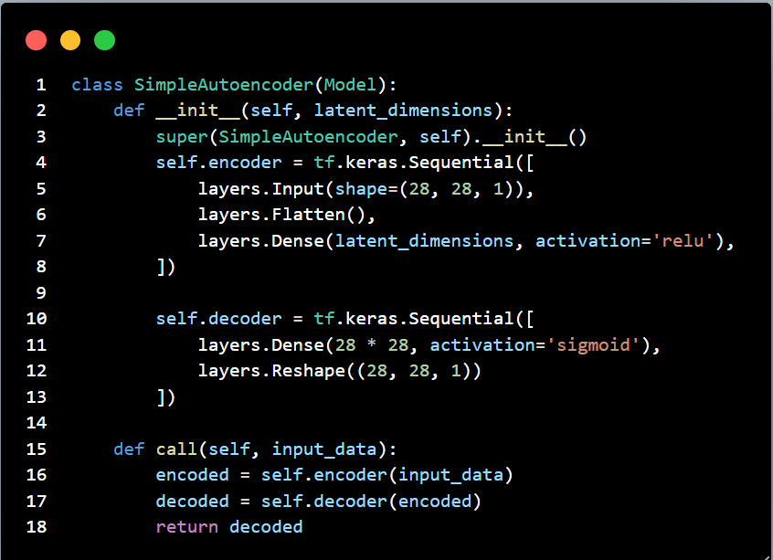
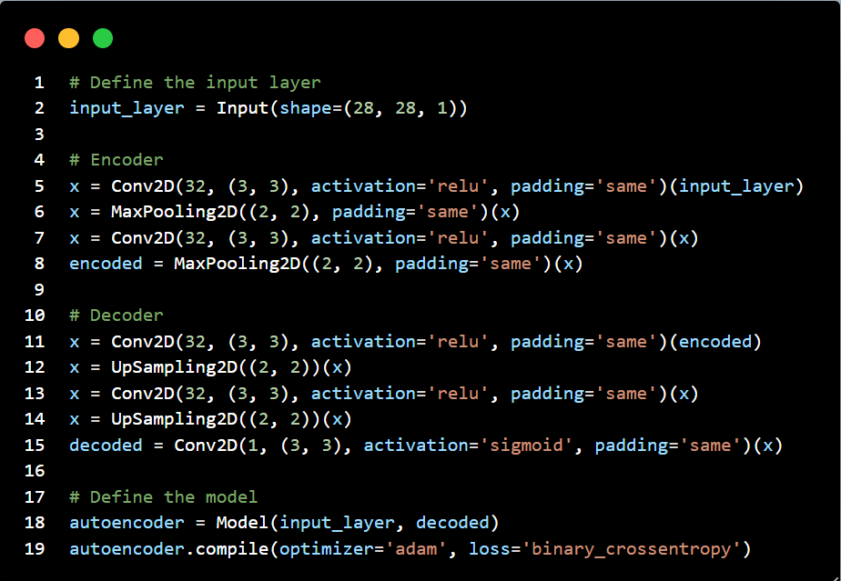
Hands-on Architecture

Slide 15
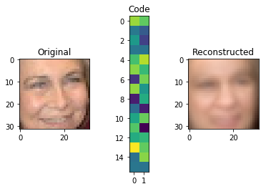
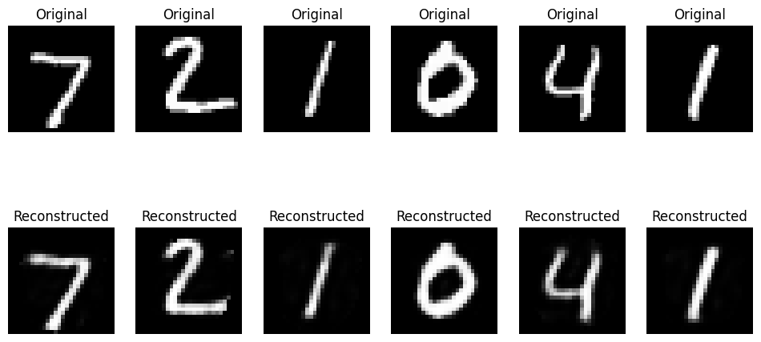
Hands-on Architecture
Image Reconstruction
From MNIST Dataset

Slide 16
Introduction to Transformers
Need for Sequence Models
Sequence modeling trains AI systems on chronologically ordered data to capture patterns and make predictions over time. More specifically, sequence models like recurrent neural networks process inputs as sequences, with each data point conditioned on those preceding it.
The model iterates through data points, maintaining an encoded representation of the sequence history at each step. This sequential processing allows the model to learn complex time-based patterns like trends, seasonality, and long-range dependencies in data.
The sequence model is trained to make predictions by estimating the probability distribution over next values, given the sequence of past context. This modeling of ordered data as interdependent steps enables the model to develop a sense of continuity and dynamics within data.
Sequence modeling is crucial for AI systems to understand data that unfolds over time. Unlike static data, temporal sequences have complex time-based patterns like trends, cycles, and lagged effects. By processing data as interdependent sequenced steps, models can learn these nuanced time dynamics rather than viewing data points in isolation.
This time-based conditioning enables models to make more contextual and accurate predictions and decisions — understanding how the past leads to the future. Sequence modeling has unlocked AI advancements in speech, text, video, forecasting, anomaly detection, and more.

Slide 17
Problems with RNNs/LSTMs
While Recurrent Neural Networks (RNNs) are powerful for sequential data, they face issues with long-term dependencies due to the vanishing gradient problem. LSTMs were developed to mitigate this by introducing gating mechanisms, but they are more complex and computationally expensive. Both RNNs and LSTMs can struggle with very long sequences and are sensitive to hyperparameter choices.
Problems with RNNs:
Vanishing Gradients: During backpropagation, gradients can shrink as they pass through many time steps, making it difficult for the network to learn long-range dependencies.
Exploding Gradients: Conversely, gradients can also grow exponentially, leading to unstable training.
Limited Memory: RNNs struggle to remember information from distant past time steps, especially with long sequences.
Slow Training: Due to their sequential nature, RNNs cannot be parallelized effectively, leading to slower training times.
Problems with LSTMs:
Complexity: LSTMs are more complex than basic RNNs, requiring more parameters and computational resources.
Training Time: The increased complexity also results in longer training times and more careful hyperparameter tuning.
Vanishing Gradients (still an issue): While LSTMs mitigate vanishing gradients, they don't completely eliminate the problem, especially in very deep architectures.
Overfitting: Due to their complexity, LSTMs can be prone to overfitting, especially with limited training data.
Implementation Challenges: The more intricate architecture of LSTMs can make them harder to implement and debug.

Slide 18
Birth of Attention Mechanism
The attention mechanism in deep learning was introduced to improve the performance of Recurrent Neural Networks (RNNs), particularly in tasks like machine translation. It addresses the limitation of RNNs in handling long sequences by allowing the model to focus on the most relevant parts of the input when generating each part of the output.
How Attention Mechanism Works?
1. Input Encoding: Input data is transformed into a format that the model can process and creating representations of the data.
2. Query Generation: A query vector is generated based on the current state or context of the model. This query tells the model what it is looking for in the input data.
3. Key-Value Pair Creation: Input is splitted into key-value pairs:
Keys represents the important information required to measure the relevant data
Values hold actual data.
4. Similarity Computation: Model calculates similarity between the query vector and each key. This helps find how relevant each part of the input is. Various methods can be used to calculate this similarity such as dot products or cosine similarity.
5. Attention Weights Calculation: Similarity scores are passed through a softmax function to find attention weights. These weights indicate the importance of each key-value pair. Attention Weight (α(s,i))=softmax(Similarity Scores(s,i))
6. Weighted Sum: Attention weights are applied to the corresponding values which helps in generating a weighted sum. This step adds the relevant information from the input based on their importance calculated by the attention mechanism.
7. Context Vector: Weighted sum act as a context vector which represents attended information from the input for relevant context for the current task.
8. Integration with the Model: Context vector is combined with the model's current state or hidden representation which provides additional information for other steps of the model.
9. Repeat: Steps 2 to 8 are repeated for each step of the model which allows the attention mechanism to focus on different parts of the input sequence or data.

Slide 19
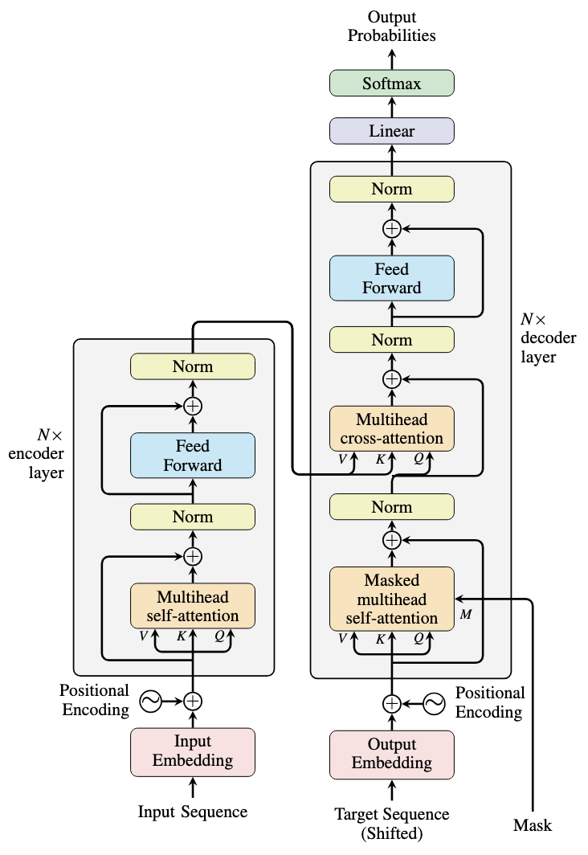
Architecture Overview
Encoder Block (Repeated N times):
Input embeddings → Positional Encoding added
Multiple layers of:
Multi-Head Self-Attention
Feedforward Neural Network
Outputs a context-rich representation of the input.
Decoder Block (Repeated N times):
Receives target input embeddings + positional encodings
Three key components per block:
Masked Multi-Head Self-Attention
Encoder-Decoder Attention (attends to encoder outputs)
Feedforward Network
Self-Attention Mechanism
Instead of processing tokens sequentially (like RNNs), each token attends to all others simultaneously.
Captures contextual relationships regardless of distance in sequence.
Positional Encoding
Transformers lack recurrence, so they need position information explicitly.
Positional Encoding is added to input embeddings to inform model about token order.
Common method: Sinusoidal functions of varying frequencies

Slide 20
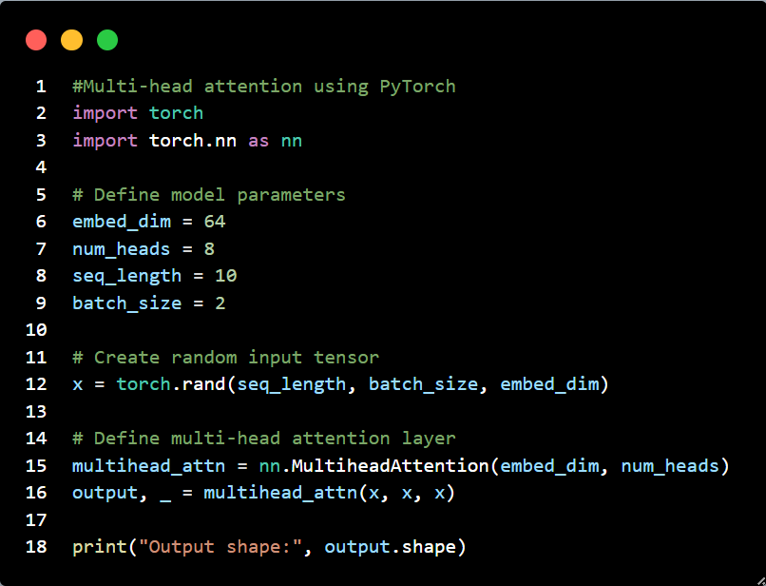
Multi-Head Attention
The multi-head attention mechanism is a key component of the Transformer architecture, introduced in the seminal paper "Attention Is All You Need" by Vaswani et al. in 2017. It plays a crucial role in enhancing the ability of models to focus on different parts of an input sequence simultaneously, making it particularly effective for tasks such as machine translation, text generation, etc.
What is Multi-Head Attention?
Multi-head attention extends self-attention by splitting the input into multiple heads, enabling the model to capture diverse relationships and patterns.
Instead of using a single set of Q,K,VQ,K,V matrices, the input embeddings are projected into multiple sets (heads), each with its own Q,K,VQ,K,V:
Linear Transformation: The input XX is projected into multiple smaller-dimensional subspaces using different weight matrices.
Independent Attention Computation: Each head independently computes its own self-attention using the scaled dot-product formula.
Concatenation: The outputs from all heads are concatenated.
Final Linear Transformation: A final weight matrix is applied to transform the concatenated output into the desired dimension.

Slide 21
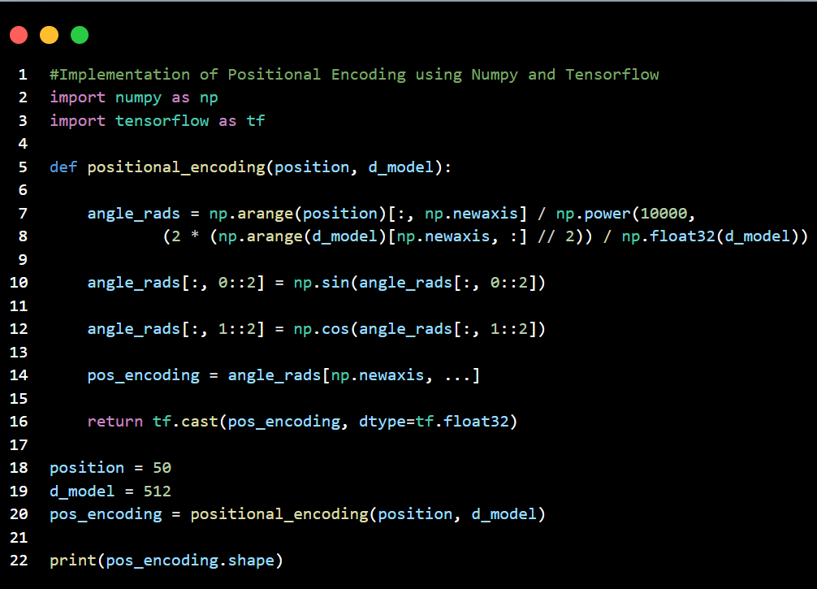
Positional Encoding
Positional encoding is a technique used in neural networks, particularly in models like Transformers, to provide information about the position of elements within a sequence. Since these models process inputs in parallel, they don't inherently understand the order of elements. Positional encoding addresses this by adding a position-specific signal to each element's representation, allowing the model to consider the sequence's structure.
How it works:
1. Embedding: Each element in the input sequence (e.g., a word in a sentence) is first converted into a vector representation called an embedding.
2. Positional Encoding Vector: A separate positional encoding vector is created for each position in the sequence.
3. Addition: The positional encoding vector is added to the corresponding element's embedding vector. This combined vector now contains both semantic (word meaning) and positional information.
Common techniques:
Sinusoidal Functions: The most common approach uses sine and cosine functions with different frequencies to generate unique positional encodings for each position.
Learnable Positional Embeddings: Another method involves creating a lookup table of embeddings, where each position has a learned vector.

Slide 22
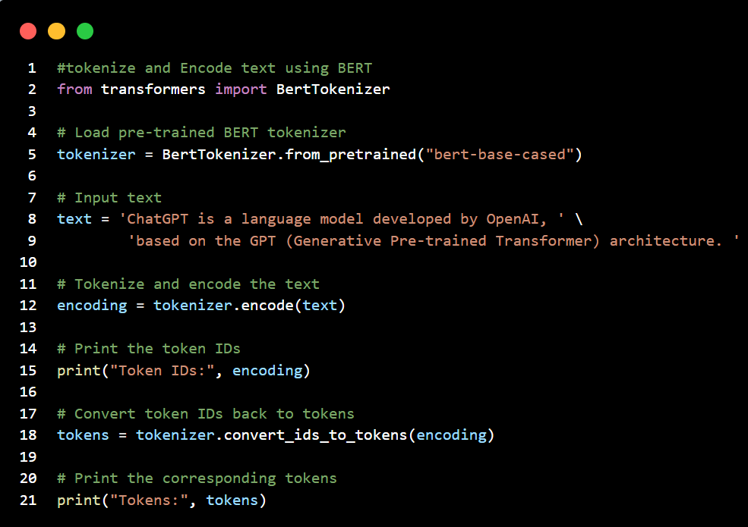
BERT (Bidirectional Encoder Representations from Transformers)
It leverages a transformer-based neural network to understand and generate human-like language. BERT employs an encoder-only architecture. The decision to use an encoder-only architecture in BERT suggests a primary emphasis on understanding input sequences rather than generating output sequences. BERT uses a bi-directional approach considering both the left and right context of words in a sentence, instead of analyzing the text sequentially, BERT looks at all the words in a sentence simultaneously.
How BERT work?
BERT is designed to generate a language model so, only the encoder mechanism is used. Sequence of tokens are fed to the Transformer encoder. These tokens are first embedded into vectors and then processed in the neural network. The output is a sequence of vectors, each corresponding to an input token, providing contextualized representations.
When training language models, defining a prediction goal is a challenge. Many models predict the next word in a sequence, which is a directional approach and may limit context learning.
BERT addresses this challenge with two innovative training strategies:
Masked Language Model (MLM): portion of words in each input sequence is masked and the model is trained to predict the original values of these masked words based on the context provided by the surrounding words
Next Sentence Prediction (NSP): transforming the output of the [CLS] token into a 2×1 shaped vector using a classification layer, and then calculating the probability of whether the second sentence follows the first using SoftMax

Slide 23
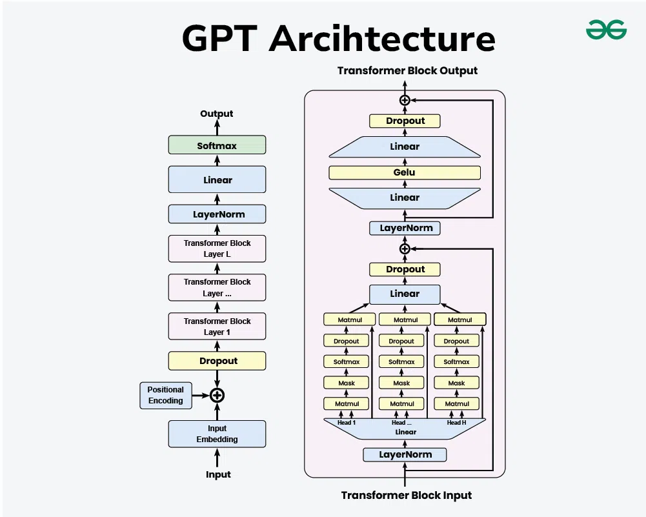
Generative Pre-trained Transformer (GPT)
It is a model, developed by Open AI to understand and generate human-like text. GPT has revolutionized how machines interact with human language making more meaningful communication possible between humans and computers. GPT is based on the transformer architecture and the core idea behind it is the use of self-attention mechanisms that processes words in relation to all other words in a sentence whereas the traditional methods that process words in sequential order. This allows the model to weigh the importance of each word no matter its position in the sentence, leading to a more nuanced understanding of language. As a generative model, GPT can produce new content.
Architecture of GPT
The transformer architecture which is the foundation of GPT models is made up of feedforward neural networks and layers of self-attention processes.
Self-Attention System: This enables the model to evaluate each word's significance within the context of the complete input sequence. It makes it possible for the model to comprehend word linkages and dependencies which is essential for producing content that is logical and suitable for its context.
Layer normalization and residual connections: By reducing problems such as disappearing and exploding gradients, these characteristics aid in training stabilization and enhance network convergence.
Feedforward Neural Networks: These networks process the output of the attention mechanism and add another layer of abstraction and learning capability. They are positioned between self-attention layers.
Applications include content creation, customer support, education, programming, healthcare, etc.

Slide 24
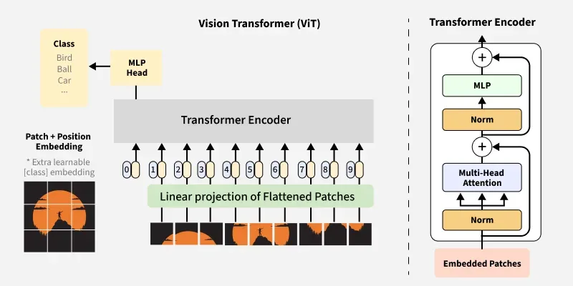
VisionTransformer (ViT)
It is an innovative deep learning architecture designed to process visual data using the same transformer architecture that revolutionized natural language processing (NLP). Unlike CNNs, which rely on convolutions to capture local spatial features, ViT adopt the self-attention mechanism to model global relationships across image patches. This architecture has demonstrated state-of-the-art performance in many computer vision tasks such as image classification, object detection, and segmentation.
Architecture of ViT
1. Image Patching and Embedding: convert the image into a sequence
of patches, similar to the tokens in an NLP model which involves
Patch Splitting, Flattening & Embedding.
2. Positional Encoding: added to each patch embedding to encode
information about the location of patches within the image which helps
the model understand spatial relationship between patches.
3. Transformer Encoder: passed through a stack of transformer
encoder layers. which consists of Multi-Head Self-Attention (MSA) and
a Feed-Forward Neural Network (FFN)
4. Classification Head (MLP Head): transformer encoders process the sequence of patches and the CLS token, the output corresponding to the CLS token is used for classification.

Slide 25
Applications of Transformer: NLP
Text Classification
Translation
Summarization
Transformers can analyze the context of words within a text and assign it to predefined categories or classes.
Examples include:
Sentiment analysis: Determining whether a piece of text expresses positive, negative, or neutral sentiment.
Spam detection: Identifying if an email or message is spam or not.
Topic classification: Categorizing news articles or social media posts into different topics.
Transformers are highly effective in machine translation, converting text from one language to another.
They can learn the relationships between words and phrases in different languages to produce accurate and fluent translations.
Examples include:
English to French translation: Translating "The weather is nice today" to "Il fait beau aujourd'hui".
Multilingual translation: Supporting translation between various language pairs.
Transformers can generate concise summaries of lengthy documents, capturing the main points and key information.
They can perform both extractive summarization (selecting sentences from the original text) and abstractive summarization (generating new sentences based on the original text).
Examples include:
Abstractive summarization of news articles: Condensing a long article into a shorter paragraph.
Query-focused summarization: Providing a summary based on a specific query or topic.
Sentence compression: Reducing the length of a sentence while preserving its meaning.

Slide 26
Applications of Transformer: ViT
Image Classification
Object Detection
ViTs treat images as sequences of patches, similar to how transformers handle text in NLP, and leverage self-attention mechanisms to understand relationships between different parts of the image.
Advantages: ViTs have shown superior performance on standard image classification benchmarks like ImageNet and CIFAR-100, especially when trained on large datasets. They can also be pre-trained on large datasets and then fine-tuned for specific classification tasks.
Examples: Image classification tasks include categorizing images of animals, objects, scenes, and more, with ViTs demonstrating high accuracy.
ViTs are used to identify and locate objects within an image, providing both the bounding box coordinates and the class of each detected object.
Advantages: ViTs' ability to capture global context allows them to better understand relationships between objects and their surroundings, leading to more accurate object detection.
Examples: Object detection applications include autonomous driving (detecting pedestrians, vehicles, traffic lights), surveillance (identifying suspicious objects), and medical imaging (detecting tumors).
DETR: DETR (DEtection TRansformer) is a notable example of a transformer-based object detection model.

Slide 27
Applications of Transformer: ViT
CLIP (Contrastive Language-Image Pre-training)
DALL-E (and DALL-E 2)
Architecture: CLIP utilizes a text encoder (a transformer) and an image encoder (a vision transformer) trained on a massive dataset of image-text pairs.
Functionality: It learns to predict which text snippet best matches a given image, allowing for zero-shot image classification and retrieval based on textual queries.
Applications:
Image classification: Categorizing images based on text descriptions.
Image retrieval: Searching for images using textual queries.
Zero-shot learning: Classifying images without explicit training on those classes.
Architecture: DALL-E is a transformer-based model that generates images from text prompts.
Functionality: It learns to associate textual descriptions with visual elements, enabling the creation of images that match textual descriptions.
Applications:
Image generation: Creating images from text prompts.
Concept art and design: Generating visual elements for various purposes.
Marketing and advertising: Creating images for products and services.
Art and design exploration: Generating unique and imaginative images.

Slide 28
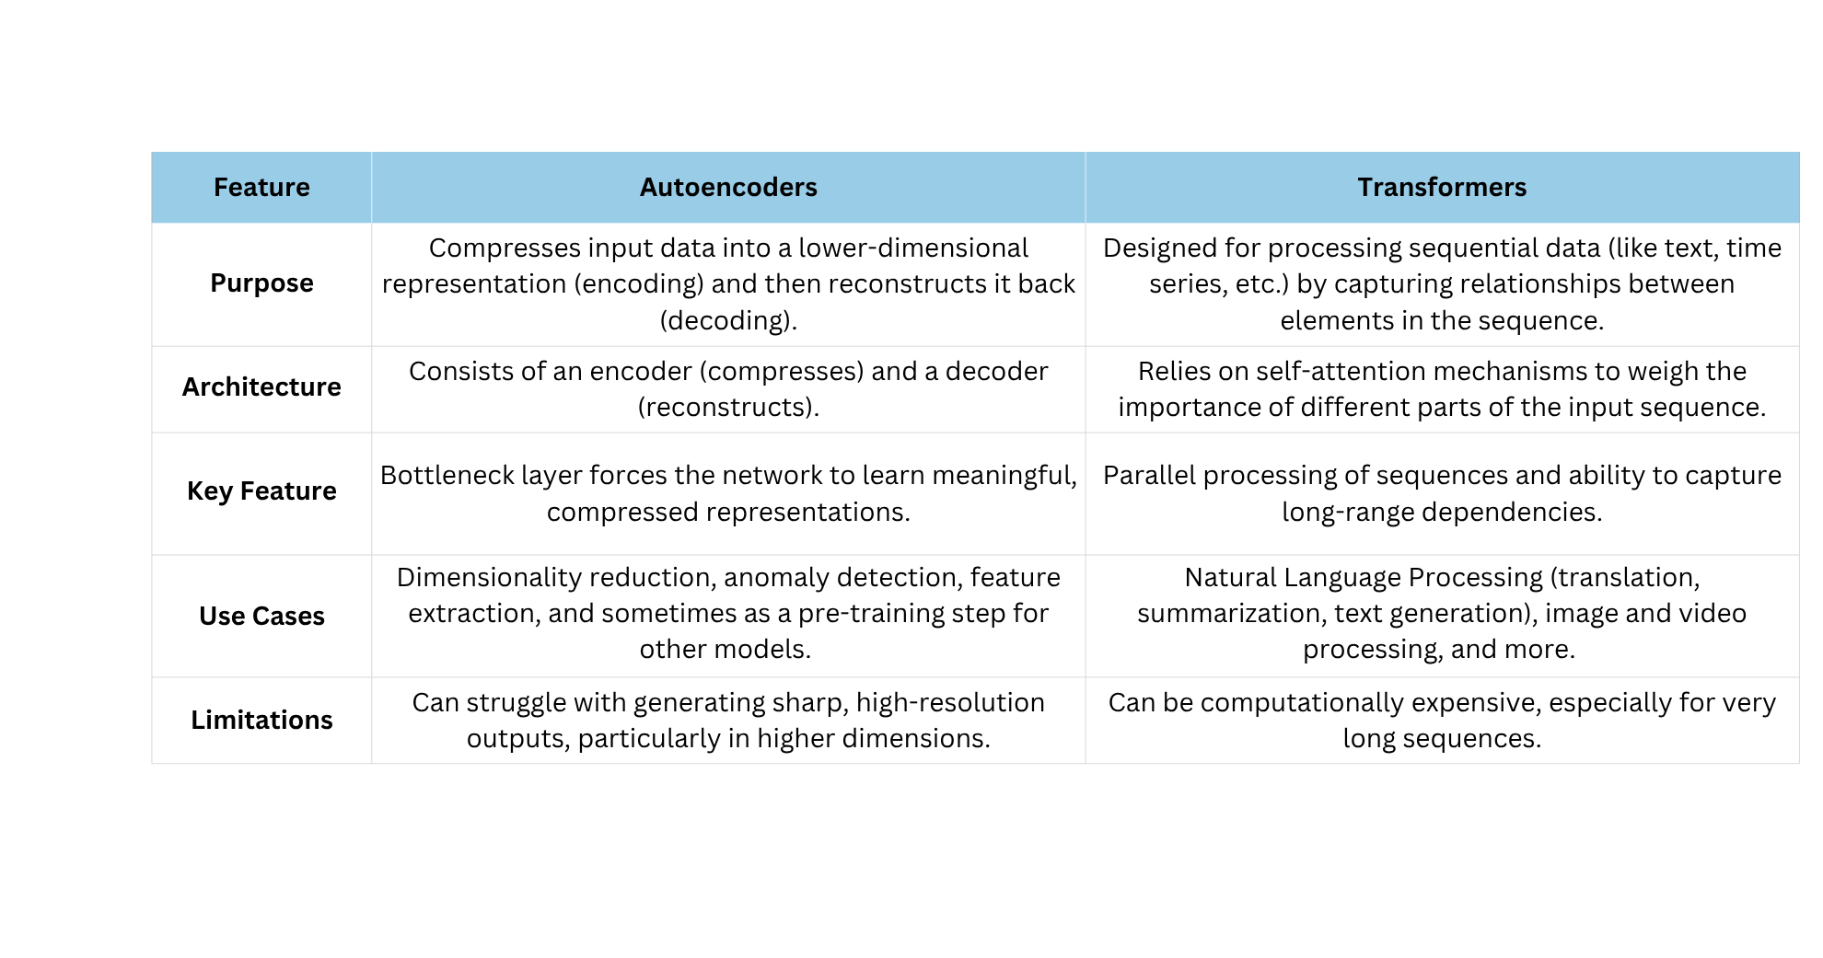
Autoencoders vs Transformers

Slide 29
Hybrid Models & Research Trends
Data Compression
Anomaly Detection
Transformer-based autoencoders are also being investigated for data compression, particularly in the context of IoT devices and next-generation wireless networks. They can effectively learn salient features and reconstruct data from partial observations, potentially reducing bandwidth and power consumption.
Hybrid models, like the one combining a transformer-based autoencoder with Isolation Forest and XGBoost, are being explored for real-time anomaly detection in wireless sensor networks. The autoencoder learns normal data patterns, while the transformer component helps in distinguishing between different types of anomalies.
Medical Imaging
Multimodal Learning
Hybrid models are being used to improve medical image reconstruction and analysis. For example, a VAE-ViT model combines the dimensionality reduction capabilities of a VAE with the classification power of a Vision Transformer (ViT) for plant disease detection.
A Transformer Autoencoder (TAE) model has been proposed for multi-modal emotion recognition, integrating different modalities like EEG and video data. The model uses modality-specific encoders and an inter-modality encoder to learn relationships between different modalities, demonstrating strong performance even with missing data.

Slide 30
Hybrid Models & Research Trends
Time Series Analysis
Attention mechanisms, inspired by transformers, are being integrated with autoencoders for unsupervised anomaly detection in time series data. This approach can capture both local and long-term dependencies in time series data, leading to improved anomaly detection accuracy.
Explainable AI (XAI)
Some hybrid models incorporate XAI techniques, like SHapley Additive exPlanations, to provide insights into feature importance and model behavior. This is particularly valuable in applications like healthcare, where understanding the reasoning behind predictions is crucial.
Musical Style Analysis
A Transformer Autoencoder has been proposed for encoding musical style, demonstrating the potential of transformers in capturing complex patterns in symbolic music data.

Slide 31

Applications in self-supervised learning
Combining SSL with other paradigms
Hybrid models integrate SSL with supervised or reinforcement learning, often leading to better performance than using any single method alone.
Market Insights:
Through comprehensive market analysis, we've identified shifts in consumer preferences, competitive landscape changes, and emerging market segments.
Customer Feedback:
Direct feedback from our customers has highlighted areas for improvement

Slide 32
When to use what?
Autoencoders
Transformers
Best for:
Unsupervised learning
Dimensionality reduction
Anomaly detection in structured data (e.g., system logs, transactions)
Data compression (e.g., medical images, satellite data)
Image denoising and reconstruction
Why Use:
Lightweight, fast to train
Suitable when labeled data is limited
Great for feature extraction
Best for:
Sequence modeling (NLP, time-series, bioinformatics)
Text generation, translation, summarization
Vision tasks with large-scale data (ViT)
Multimodal models (e.g., image + text, CLIP)
Pretraining large models (BERT, GPT)
Why Use:
Handles long-range dependencies
Parallelizable (unlike RNNs)
Dominant architecture for state-of-the-art results

Slide 33
Thank you

